Slide 1
Using python to solve CFD problems
20th November 2024

Slide 2
Python
An interpreted language (not compiled)
Easy syntax
Large community support
Multi-purpose
Intuitive

Slide 3
First thing first
After installing the interpreter, we can surely write our code in notepad using the .py extension and run using python3 example.py. But, to make it easier to debug, find errors, move between several functionalities we need development environments like vscode.
Download VsCode: here
Just like we install compilers like Dev C++, Octave to run the code in C++, matlab. We also need interpreter to run python codes:
Python Download: here

Slide 4
Creating virtual environment
In python, there are several packages like numpy, matplotlib that get continuously updated. Update means changing the codebase; can either be re-writing previous codebase more efficiently or adding a new functionality. Due to this reason, sometimes packages used some time ago might not work the same way in the later tries. So, it’s always better to use virtual environments to ensure the code always run regardless of the update.
Basic convention (while using other people code):
Create your own virtual environment
In the repository, there will be requirements.txt file or similar and you do:
pip install -r requirements.txt

Slide 5
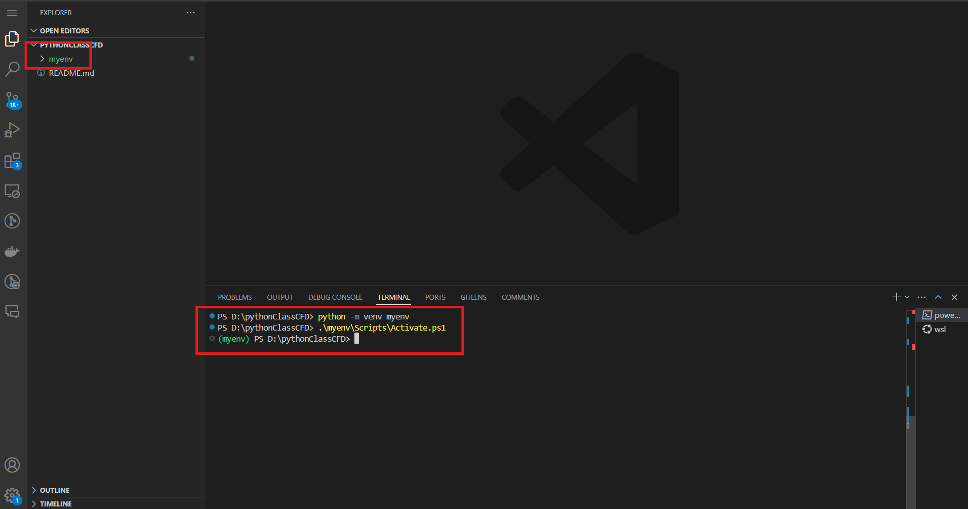
Venv contd.

Slide 6

QR Code
Github link: https://github.com/shilaj/pythonClassCFD

Slide 7
Changes to be made in class:
Change the width of the wave (for advection case)
You can try on forward and central difference scheme too.
Apply Neumann condition on the left boundary (for diffusion case)
Change the initial temperature value to some other value and see how the plot changes.

Slide 8
Queries?

